Slide 1


Foundations of
Scientific Computing
Dave Biersach
dbiersach@bnl.gov
Session 03
2D Graphics

Slide 2
Session 03 – Goals
Plot 2-D equations using the Python package matplotlib
Relate the plot's figure object to its axes object
Learn how to decorate plots with titles, labels, grids, etc.
Review vectorized operations that implicitly operate on an entire NumPy array with just one algebraic expression
Plot a conic section (a parabola)
Plot another conic section (a circle) using polar to Cartesian coordinate conversion
Plot parametric equations using polar graphs

Slide 3
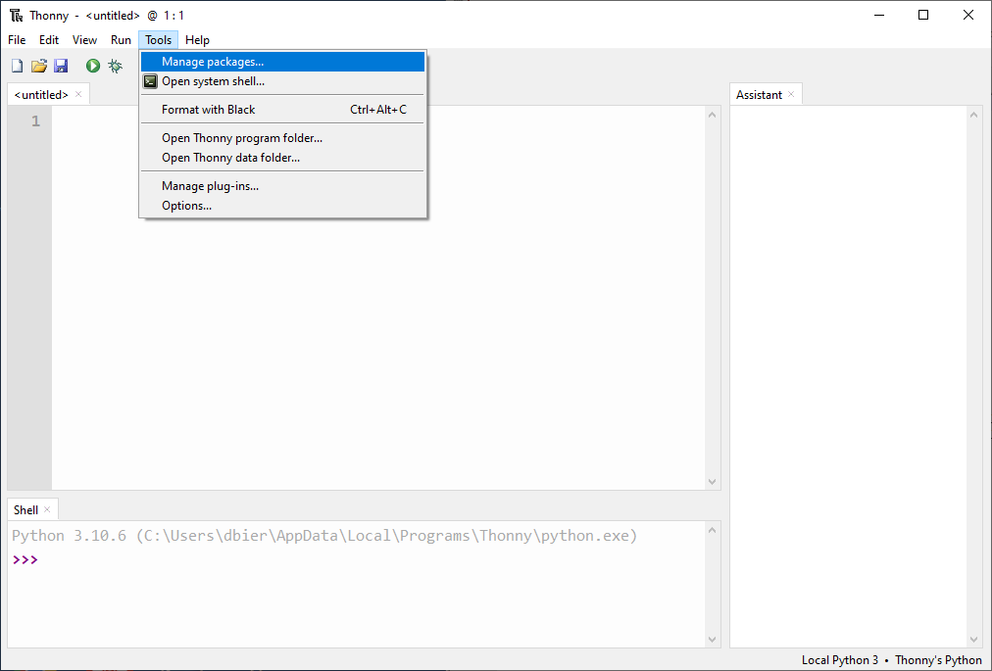
Installing Python Packages into Thonny

Slide 4
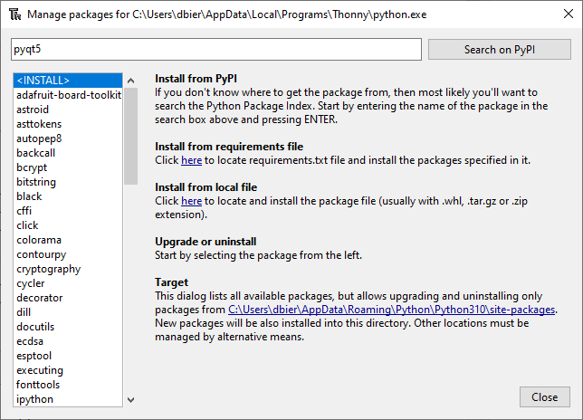
Find the Package PyQt5 on PyPI

Slide 5
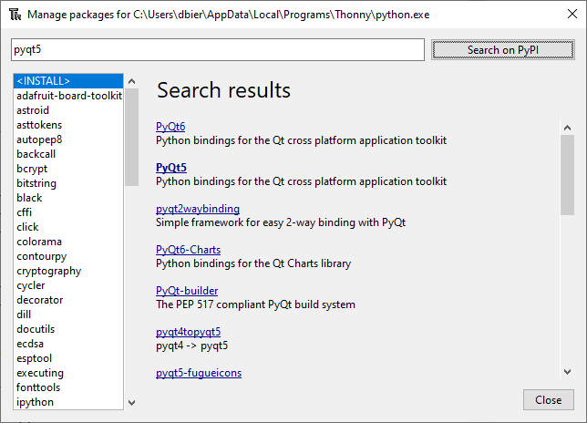
Select the PyQt5 Package Name

Slide 6
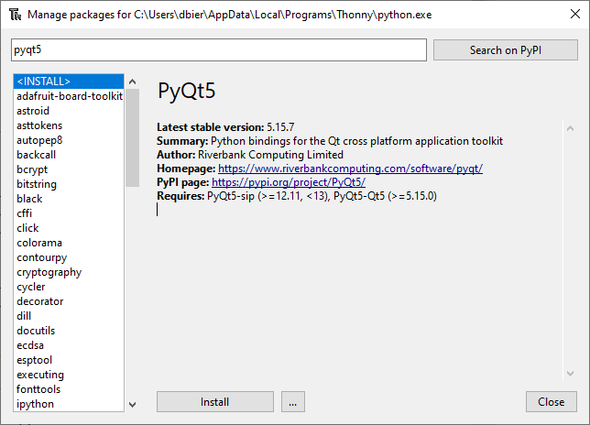
Install the PyQt5 Package

Slide 7
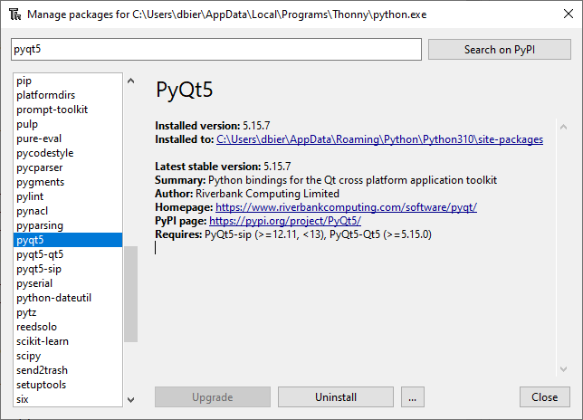
Verify the PyQt5 Package Installation

Slide 8
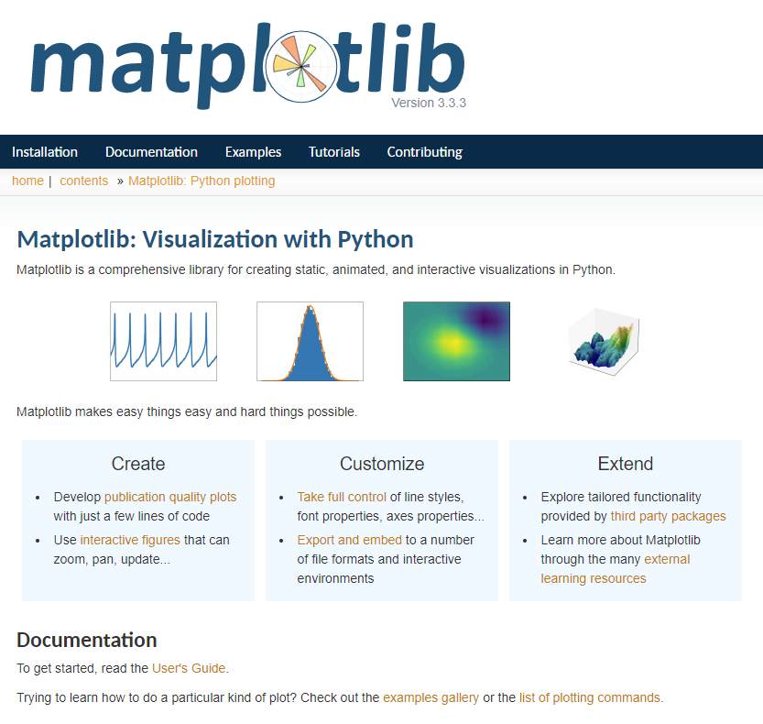
https://matplotlib.org

Slide 9
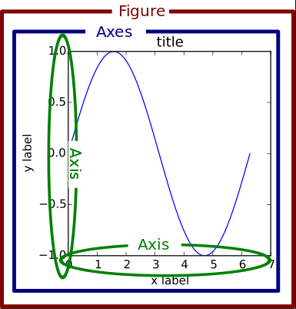
Matplotlib Container Hierarchy

Slide 10
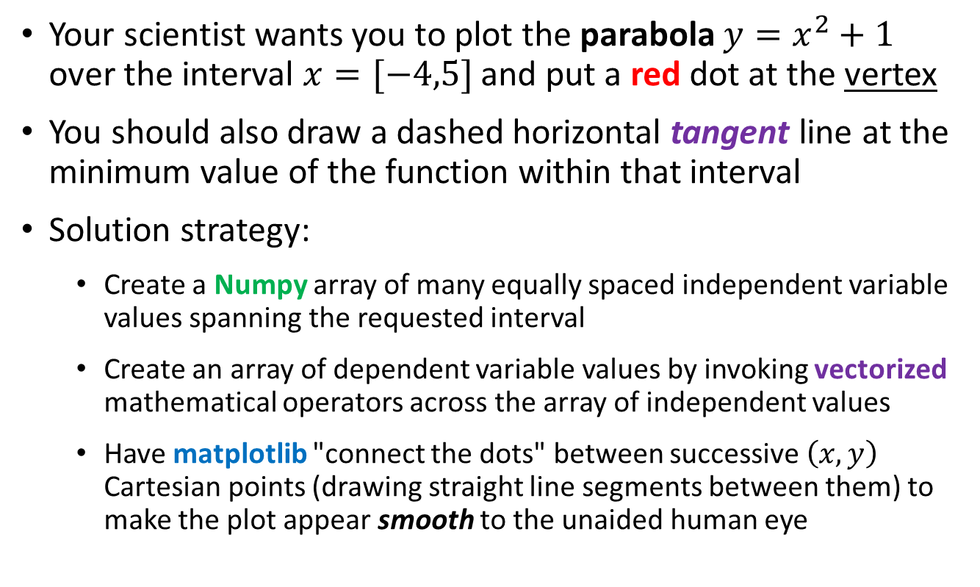
Drawing a Conic Section
Your scientist wants you to plot the parabola $y=x^{2}+1$ over the interval $x=[−4,5]$ and put a red dot at the vertex
You should also draw a dashed horizontal tangent line at the minimum value of the function within that interval
Solution strategy:
Create a Numpy array of many equally spaced independent variable values spanning the requested interval
Create an array of dependent variable values by invoking vectorized mathematical operators across the array of independent values
Have matplotlib "connect the dots" between successive $\left(x,y\right)$ Cartesian points (drawing straight line segments between them) to make the plot appear smooth to the unaided human eye

Slide 11
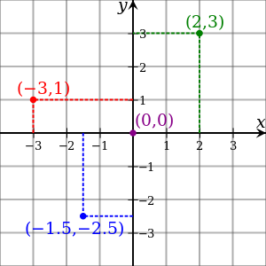
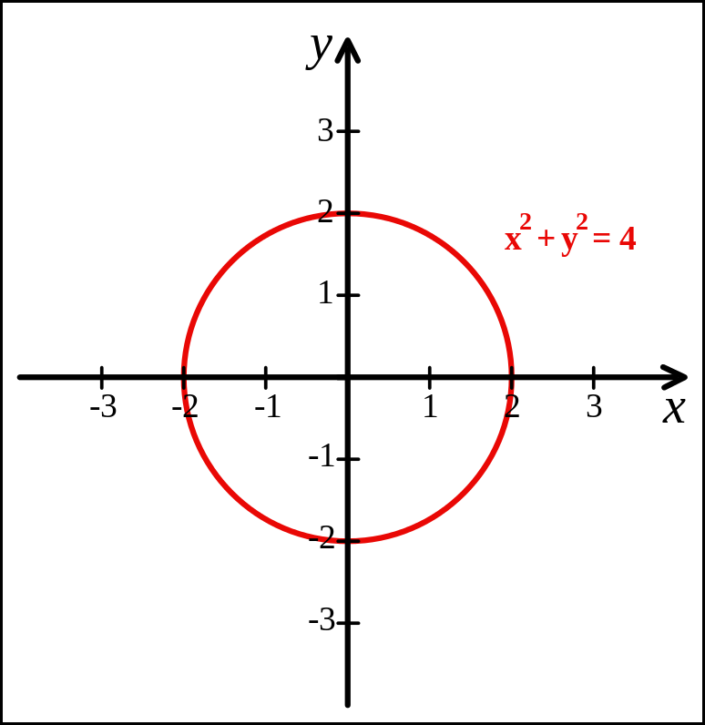
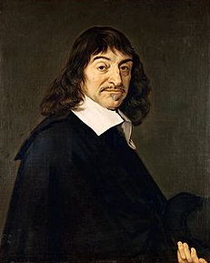
Cartesian Coordinates
Created by René Descartes in 1637

Slide 12
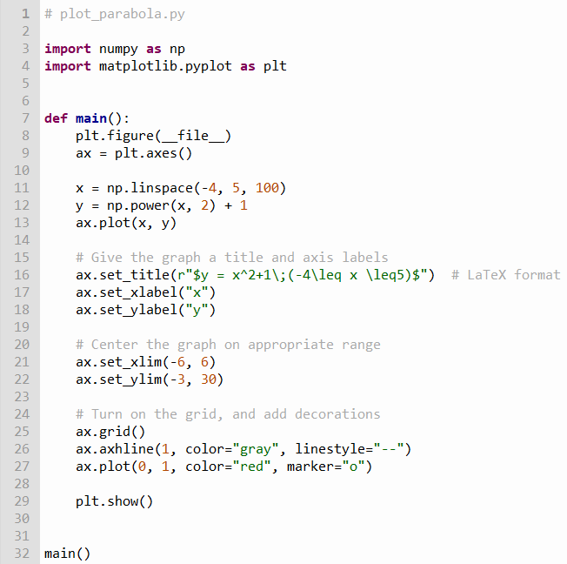

Edit plot_parabola.py
①
②
③
⑤
④
$$y=x^{2}+1$$
⑥
⑦
Type this code into your Thonny IDE
⑧
⑨
⑩

Slide 13
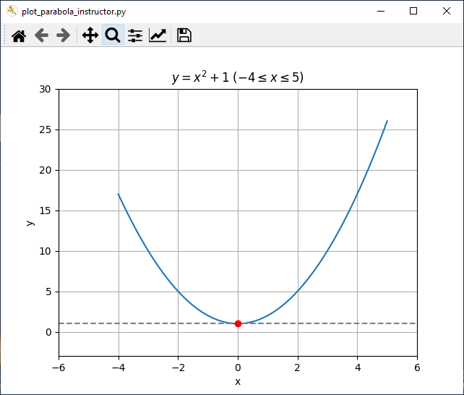
Run plot_parabola.py

Slide 14

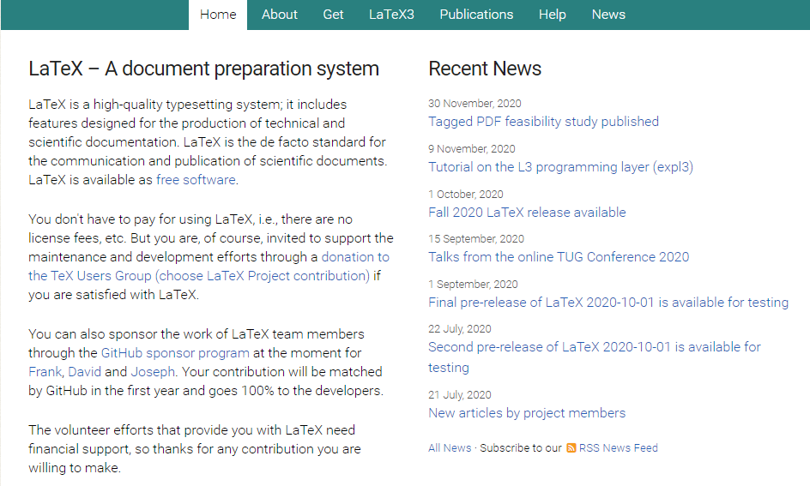
https://www.latex-project.org

Slide 15
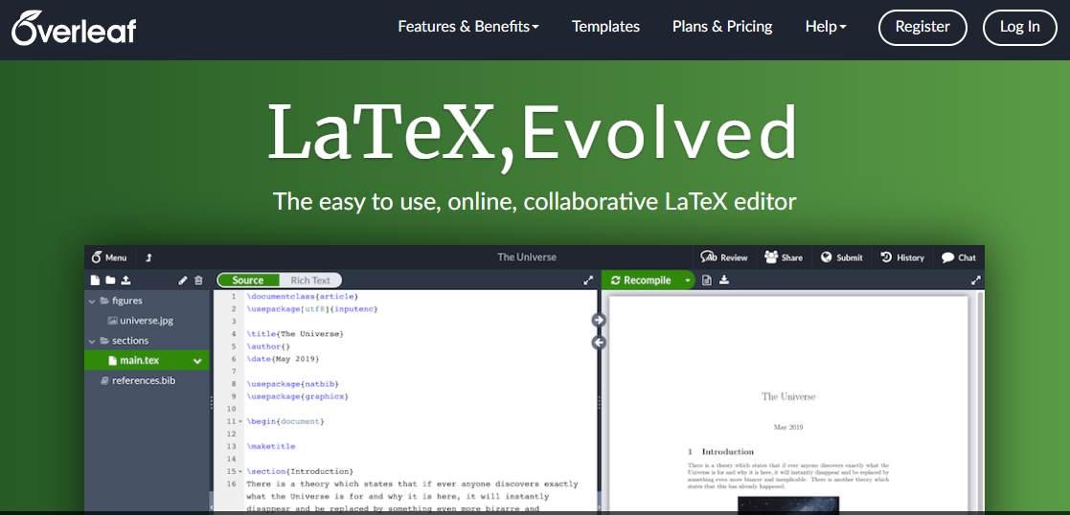
https://www.overleaf.com

Slide 16
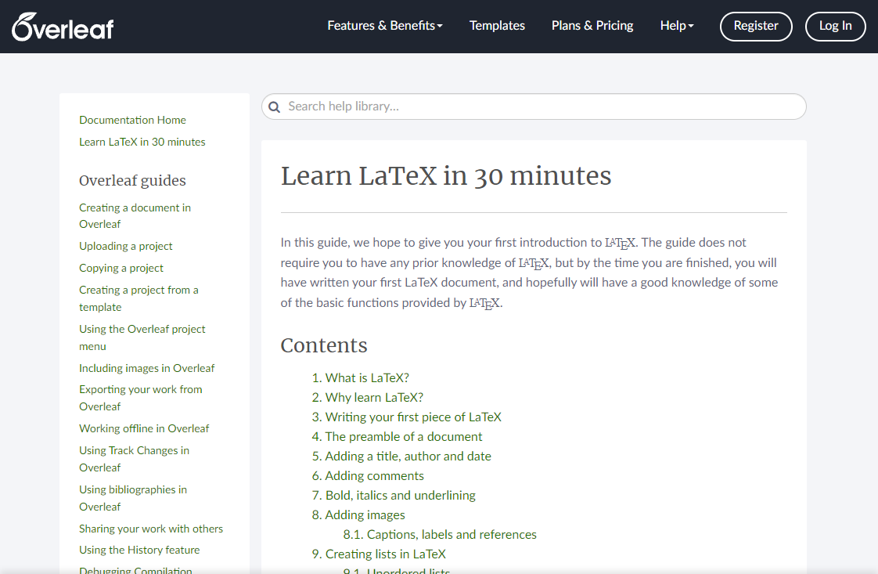
https://www.overleaf.com/learn/latex/Learn_LaTeX_in_30_minutes

Slide 17
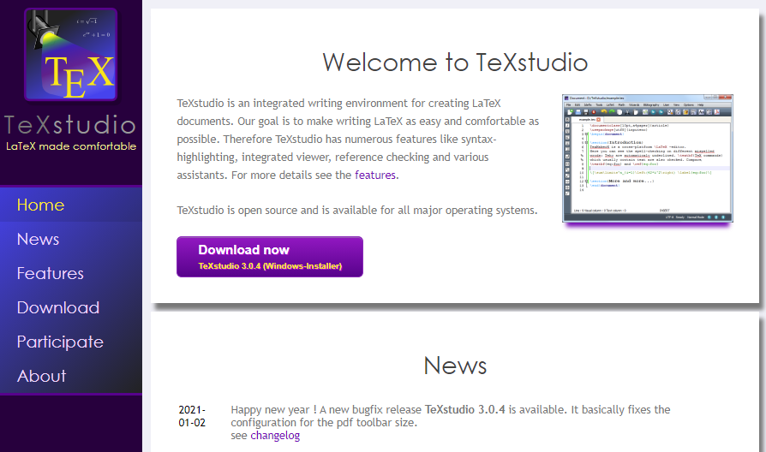
https://www.texstudio.org
100% free – runs on Windows, Mac, Linux

Slide 18
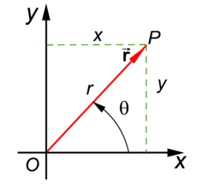
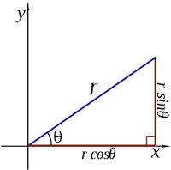
Polar Coordinates
A radius and an angle (theta)
make a 2D polar coordinate
$$(r∗\cos{θ, r ∗ \sin{θ)}}$$

Slide 19
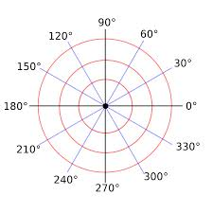
Polar Coordinates

Slide 20
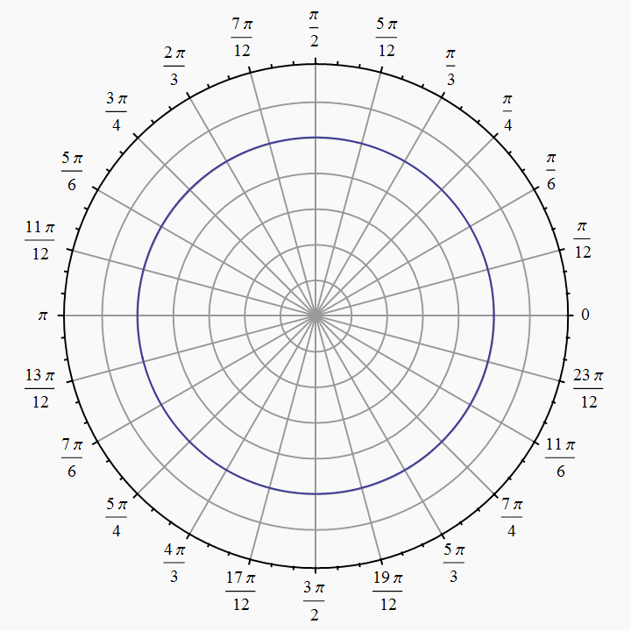
Polar Coordinates
Angles are measured in
radians
(0 ≤ θ ≤ $2π)$

Slide 21
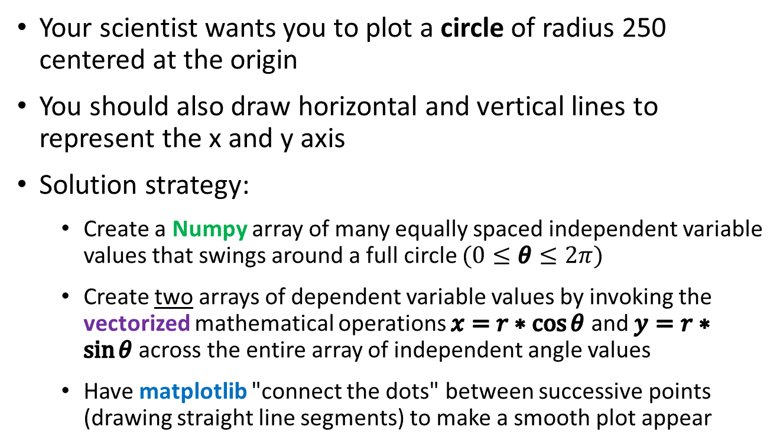
Polar to Cartesian Coordinate Conversion
Your scientist wants you to plot a circle of radius 250 centered at the origin
You should also draw horizontal and vertical lines to represent the x and y axis
Solution strategy:
Create a Numpy array of many equally spaced independent variable values that swings around a full circle $(0≤θ≤2π)$
Create two arrays of dependent variable values by invoking the vectorized mathematical operations $x=r∗\cos{θ}$ and $y=r∗\sin{θ}$ across the entire array of independent angle values
Have matplotlib "connect the dots" between successive points (drawing straight line segments) to make a smooth plot appear

Slide 22
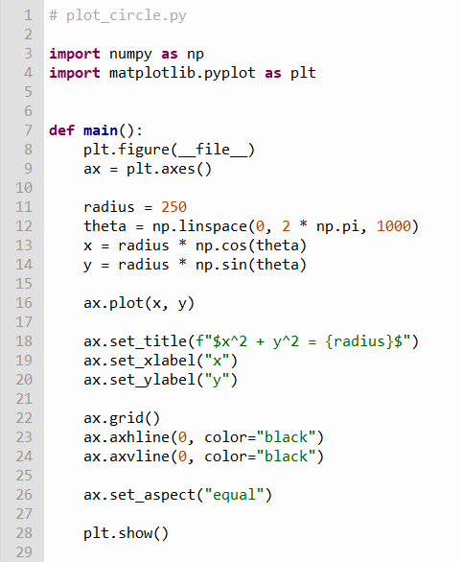
Edit plot_circle.py
①
②
③
④
⑤
⑥
Type this code into your Thonny IDE
⑦
⑧

Slide 23
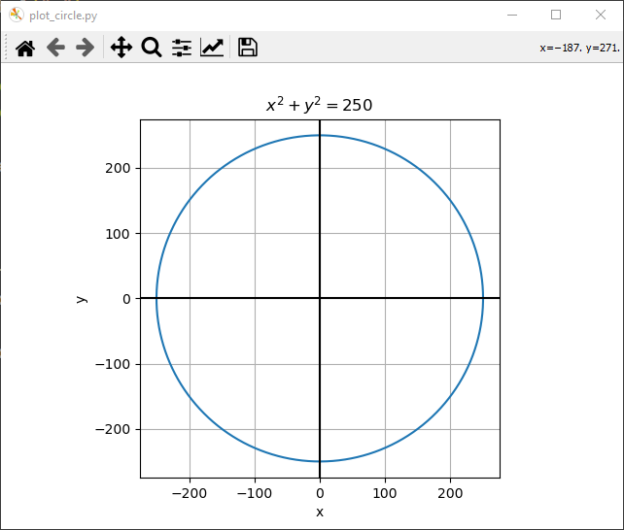
Run plot_circle.py
That looks like a circle!
☺

Slide 24
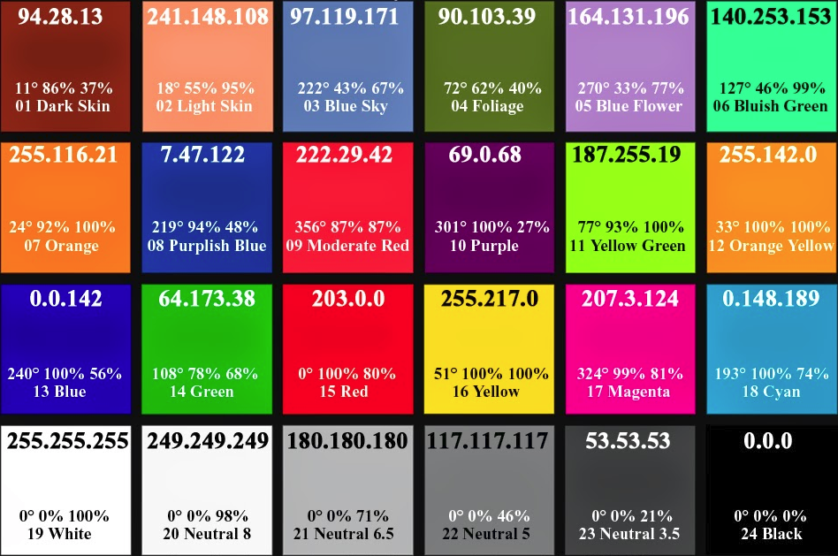
Various Colors in RGB Values

Slide 25
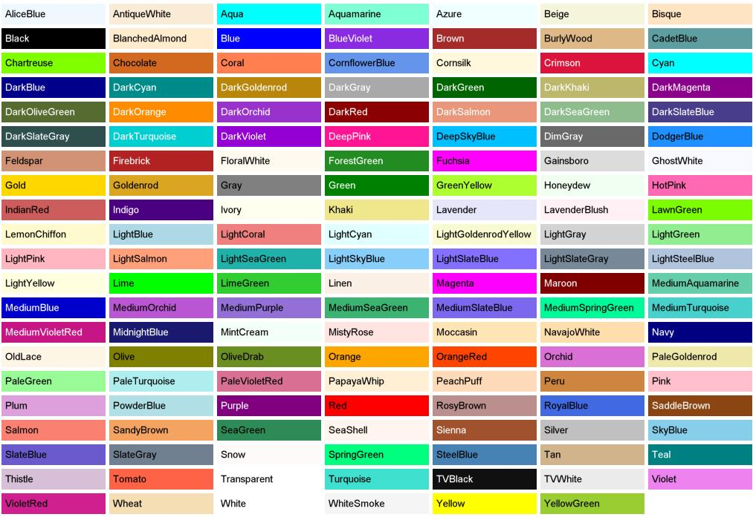
Predefined Color “Names”

Slide 26
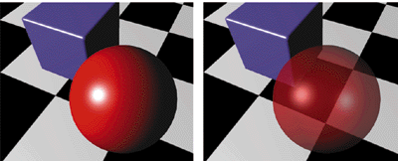
Alpha Blending = Opacity
Alpha = 0 means fully transparent (see through)
Alpha = 255 means fully opaque

Slide 27
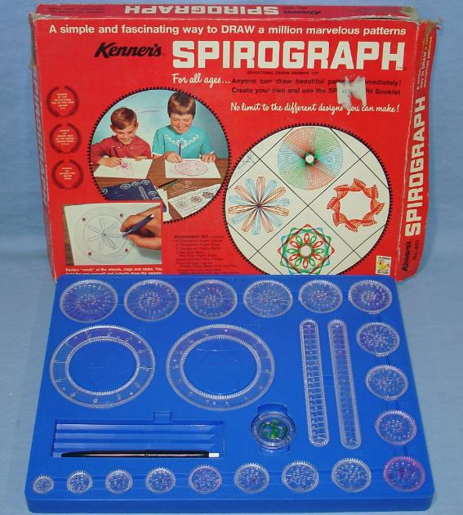
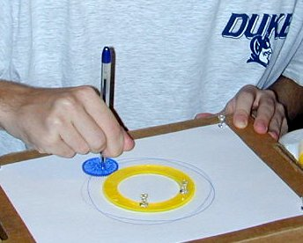
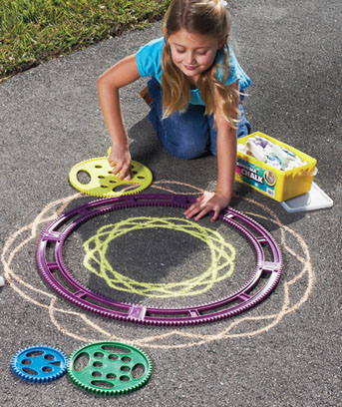

Parametric Curves

Slide 28
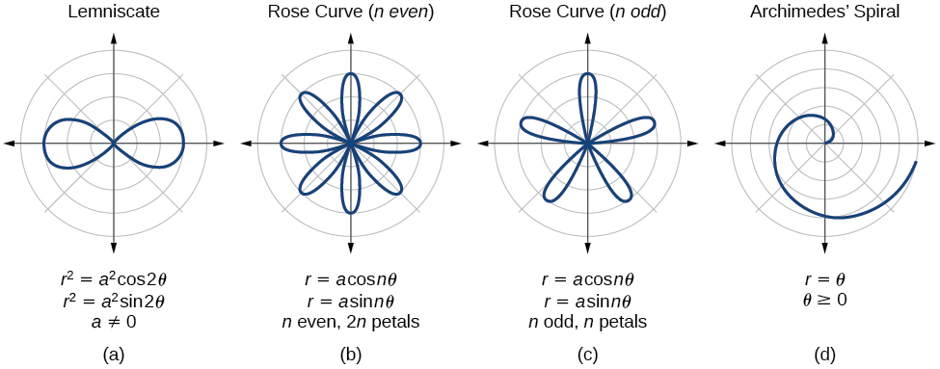
Parametric Curves
The two parameters a, n are used to calculate the current radius $r$ as $θ$sweeps the circle

Slide 29
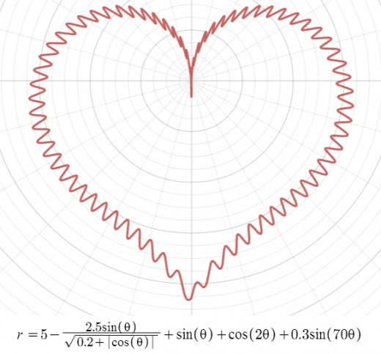
Parametric Curves

Slide 30
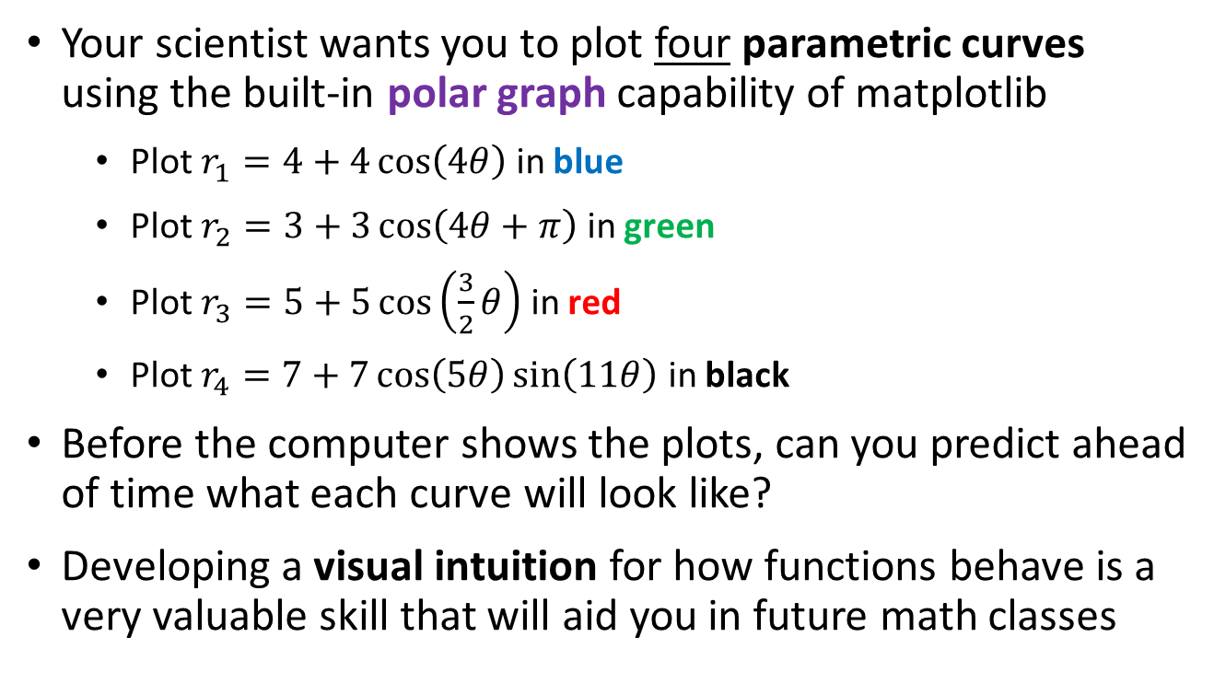
Parametric Curves Using Polar Graphs
Your scientist wants you to plot four parametric curves using the built-in polar graph capability of matplotlib
Plot $r_{1}=4+4\cos\left(4θ\right)$ in blue
Plot $r_{2}=3+3\cos\left(4θ+π\right)$ in green
Plot $r_{3}=5+5\cos\left(\frac{3}{2}θ\right)$ in red
Plot $r_{4}=7+7\cos\left(5θ\right)\sin\left(11θ\right)$ in black
Before the computer shows the plots, can you predict ahead of time what each curve will look like?
Developing a visual intuition for how functions behave is a very valuable skill that will aid you in future math classes

Slide 31
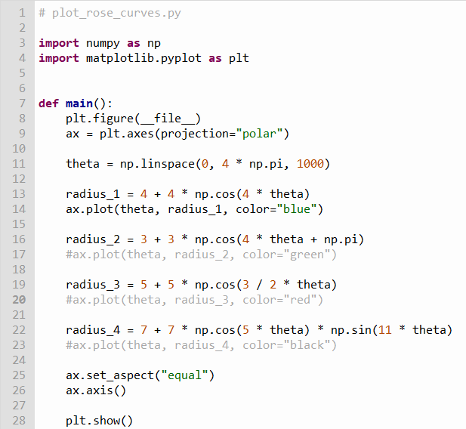
Edit plot_rose_curves.py
①
②
③
④
⑤
⑥
Type this code into your Thonny IDE
⑦

Slide 32
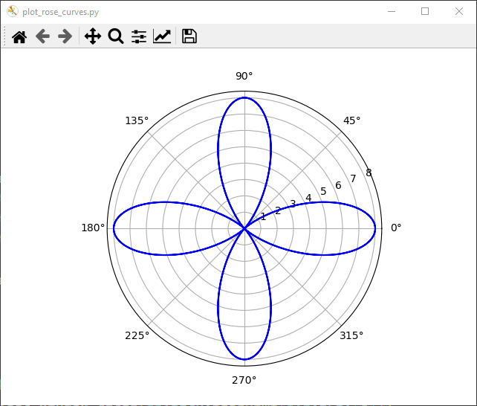
Run plot_rose_curves.py
Don't forget to close the plot window after each run!
$$r_{1}=4cos\left(4θ\right)+4$$

Slide 33
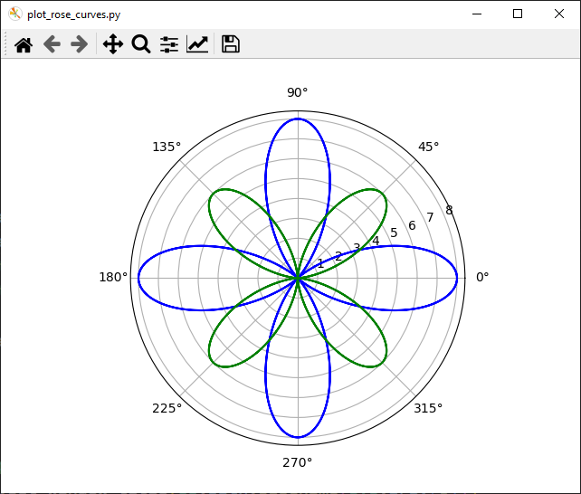
Uncomment Line 17 then Run again
$$r_{1}=4cos\left(4θ\right)+4$$
$$r_{2}=3cos\left(4θ+π\right)+3$$

Slide 34
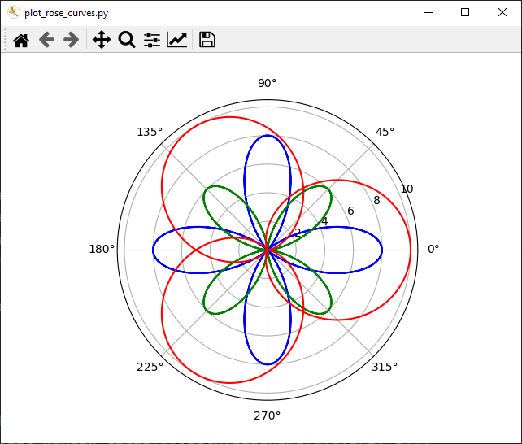
Uncomment Line 20 then Run again
$$r_{1}=4cos\left(4θ\right)+4$$
$$r_{2}=3cos\left(4θ+π\right)+3$$
$$r_{3}=5cos\left(\frac{3}{2}θ\right)+5$$

Slide 35
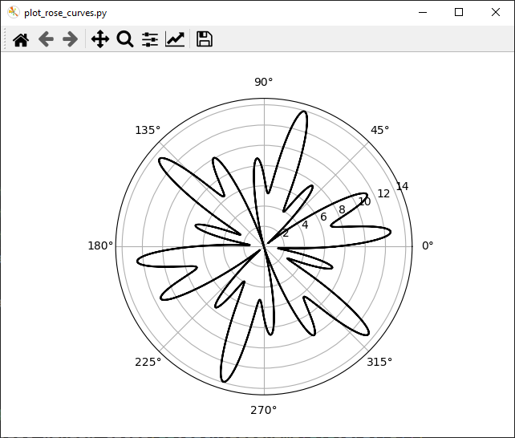
Comment Out Lines 14, 17, 20 Uncomment Line 23 then Run again
$$r_{4}=7cos\left(5θ\right)\sin\left(11θ\right)+7$$

Slide 36
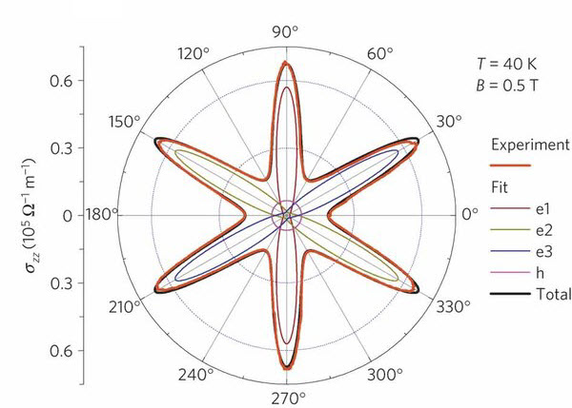
Parametric Curves
Field Induced Polarization of Dirac Valleys in Bismuth*
$$r=\sin^{2}\left(\frac{6}{5}θ\right)+\cos^{2}\left(\frac{6}{1}θ\right)$$
*Bismuth is the element with the highest atomic mass that is stable

Slide 37
Session 03 – Now You Know…
The package matplotlib, and its pyplot collection of functions, use a hierarchy of containers
You get a reference to a figure which contains an axes object
You pass numpy arrays to matplotlib – create them using linspace() and vectorized mathematical operators
Always size (domain and range) and decorate your plots with appropriate labels
The more intervals you calculate the smoother the curve will look but the longer it will take to draw
Be mindful when drawing circles to maintain proper plot aspect ratio when rendering on a rectangular screen
Learn LaTeX – all professional publishers expect science papers to be submitted using LaTeX, not MS Word

Slide 38
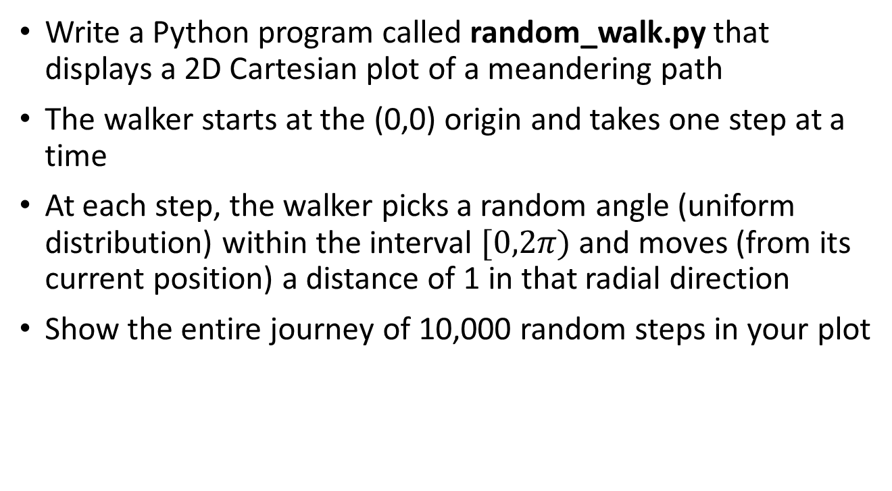
Task 03
Write a Python program called random_walk.py that displays a 2D Cartesian plot of a meandering path
The walker starts at the (0,0) origin and takes one step at a time
At each step, the walker picks a random angle (uniform distribution) within the interval $[0,2π)$ and moves (from its current position) a distance of 1 in that radial direction
Show the entire journey of 10,000 random steps in your plot

Slide 39
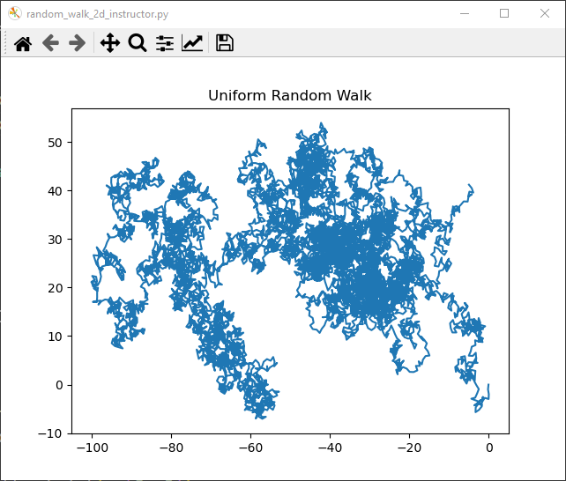
Task 03
This is just one example of the output

